Slide 1
Human Resource Management
Topic: Social responsibilities and Business Ethics
Dr. C. Vijaya Banu
Professor , School of Management
SASTRA Deemed University, Thanjavur – 613 401
vijayabanu@mba.sastra.edu

Slide 2

Social responsibilities and Business Ethics

Slide 3
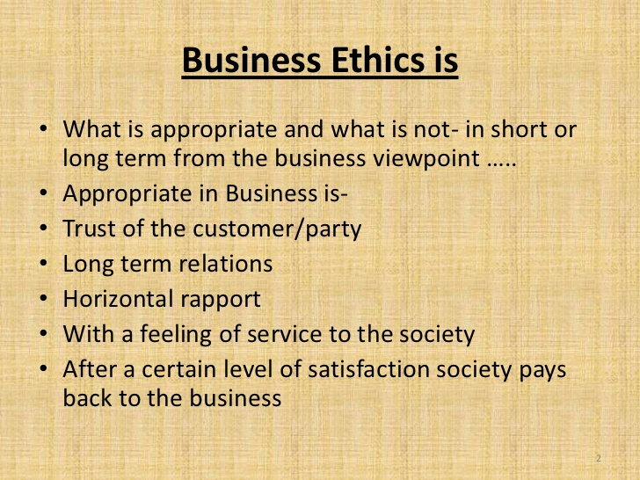

Slide 4
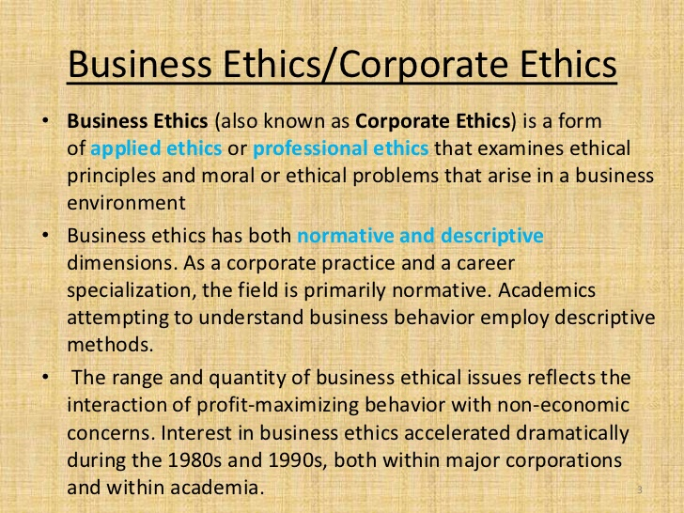

Slide 5
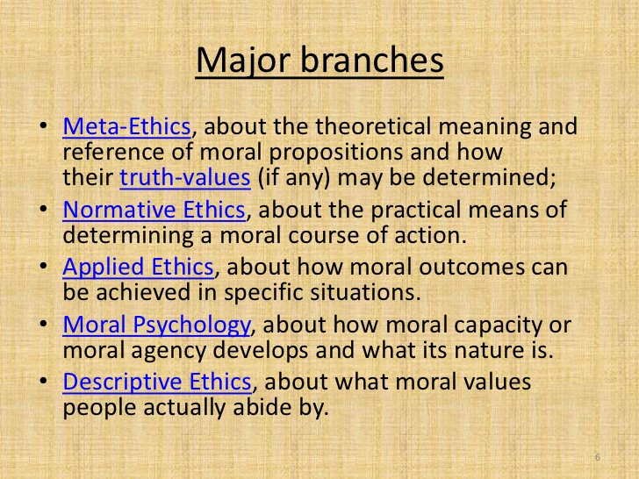

Slide 6
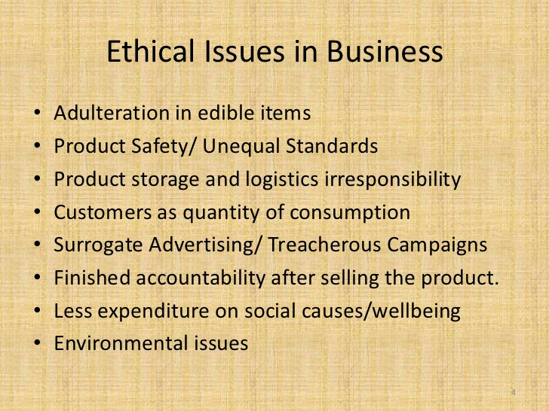

Slide 7
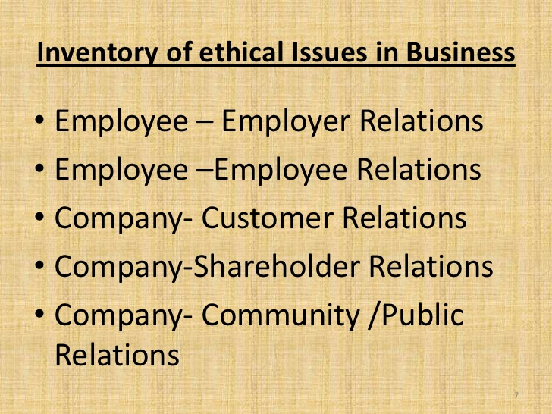

Slide 8


Slide 9
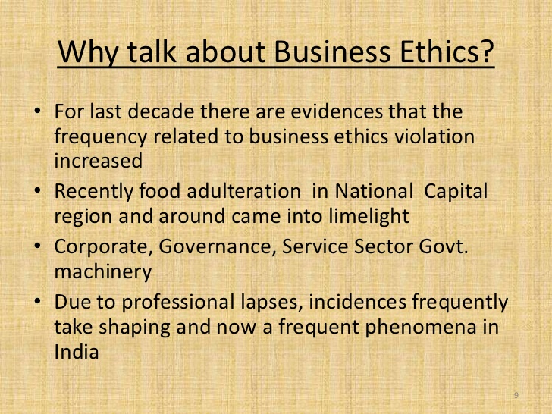

Slide 10
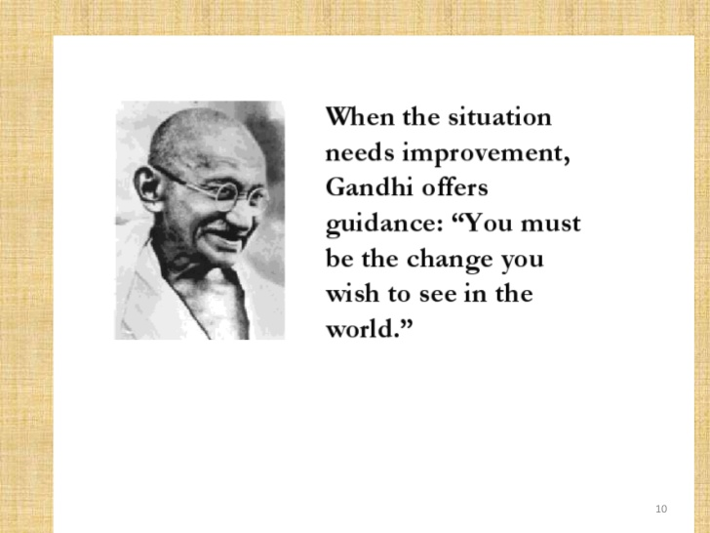

Slide 11
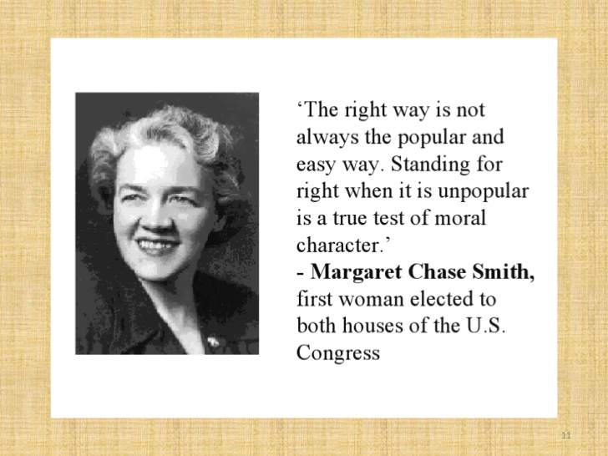

Slide 12
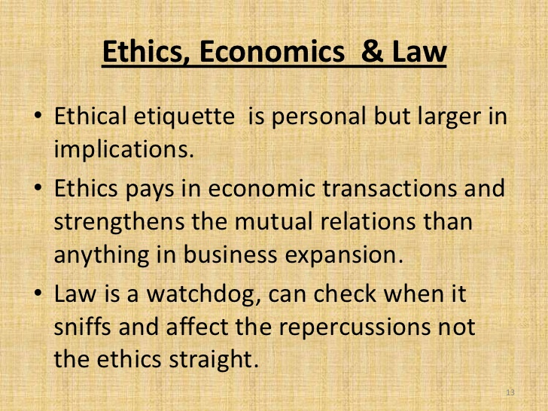

Slide 13
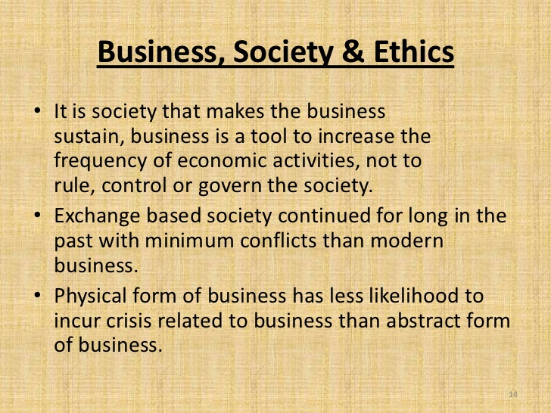

Slide 14
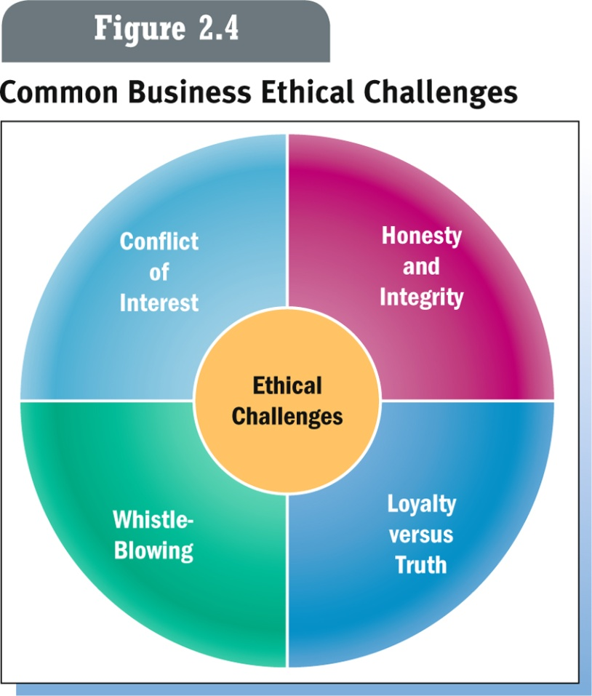

Slide 15
Whistle-blowing
Whistle-blowing brings two moral values, fairness and loyalty, into conflict. ... A virtuous whistle-blower acts in an ethical manner if she truly believes a responsibility exists to protect the public interest
A simple formula: whistleblowing is exactly as ethical as the practices it exposes are unethical
Most ethicists agree whistleblowing is an ethical action. According to the “standard theory” on whistleblowing, whistleblowing is morally required when it is required at all; people have a moral obligation to prevent serious harm to others if they can do so with little costs to themselves.

Slide 16
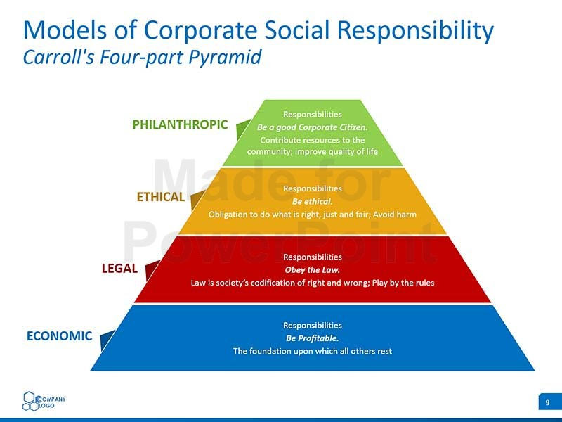

Slide 17
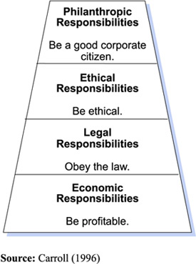
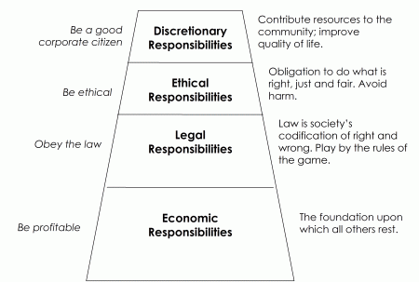
Business Ethics -model

Slide 18
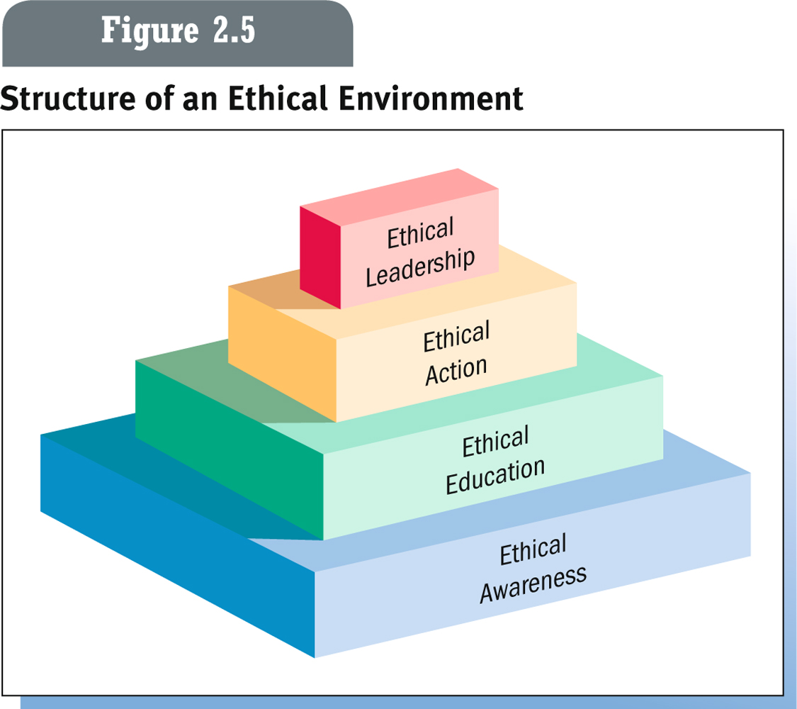
How Organizations
Shape Ethical Conduct

Slide 19
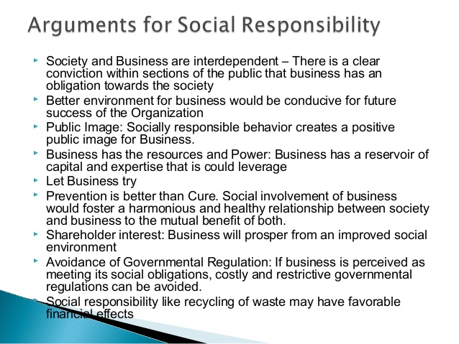

Slide 20
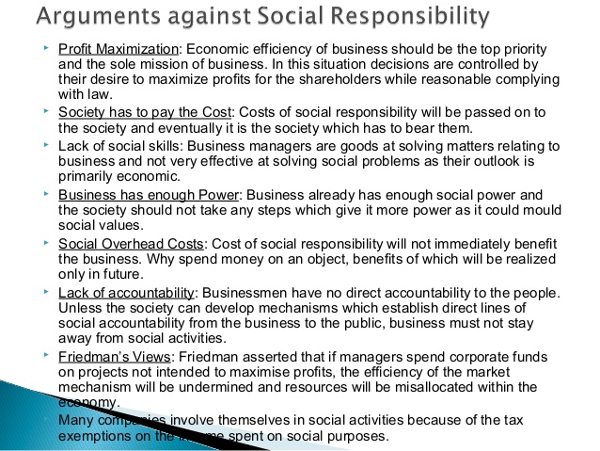

Slide 21
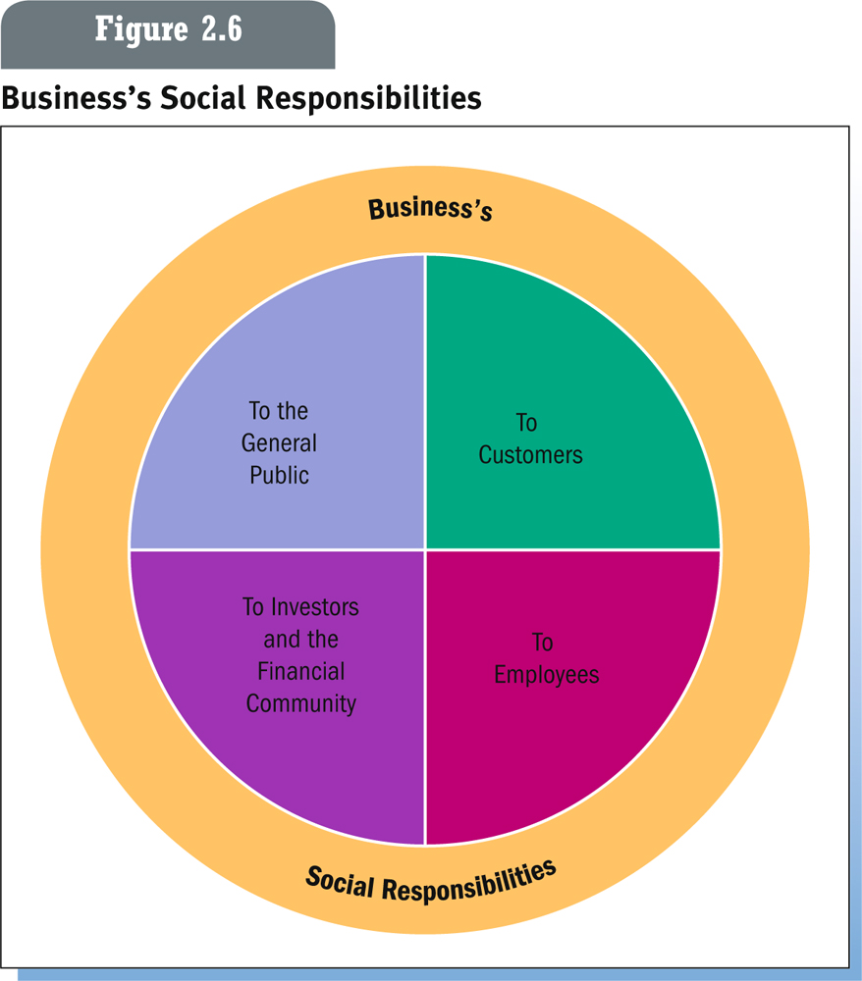
Areas of Responsibility

Slide 22
Responsibilities to
the General Public
Public Health Issues. What to do about inherently dangerous products such as alcohol, tobacco, vaccines, and steroids.
Protecting the Environment. Using resources efficiently, minimizing pollution.
Recycling. Reprocessing used materials for reuse.
Developing the Quality of the Workforce. Enhancing quality of the overall workforce through education and diversity initiatives.
Corporate Philanthropy. Cash contributions, donations of equipment and products, and supporting the volunteer efforts of company employees.

Slide 23
Responsibilities to Customers
The Right to Be Safe. Safe operation of products, avoiding product liability.
The Right to Be Informed. Avoiding false or misleading advertising and providing effective customer service.
The Right to Choose. Ability of consumers to choose the products and services they want.
The Right to Be Heard. Ability of consumers to express legitimate complaints to the appropriate parties.

Slide 24
Responsibilities to Employees
Workplace Safety. Monitored by Occupational Safety and Health Administration.
Quality-of-Life Issues. Balancing work and family through flexible work schedules, subsidized child care, through regulation
Ensuring Equal Opportunity on the Job. Providing equal opportunities to all employees without discrimination; many aspects regulated by law.
Payment of Wages 1936
Minimum wages Act 1948
Consumer protection Act 1986
Child labour prohibition and regulation act 1986

Slide 25
Responsibilities to Investors
Obligation to make profits for shareholders.
Expectation of ethical and moral behavior.
Investors protected by regulation by the Securities and Exchange Commission and state regulations.

Slide 26
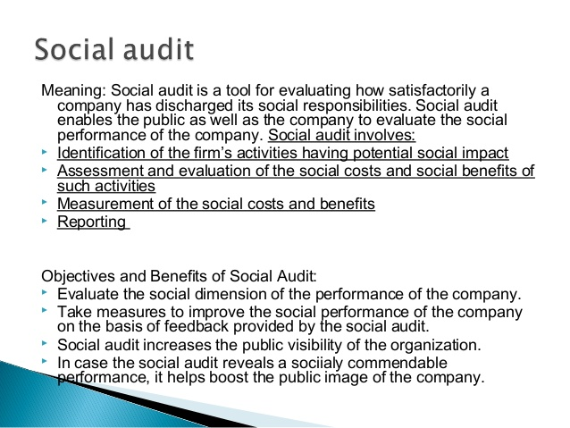

Slide 27
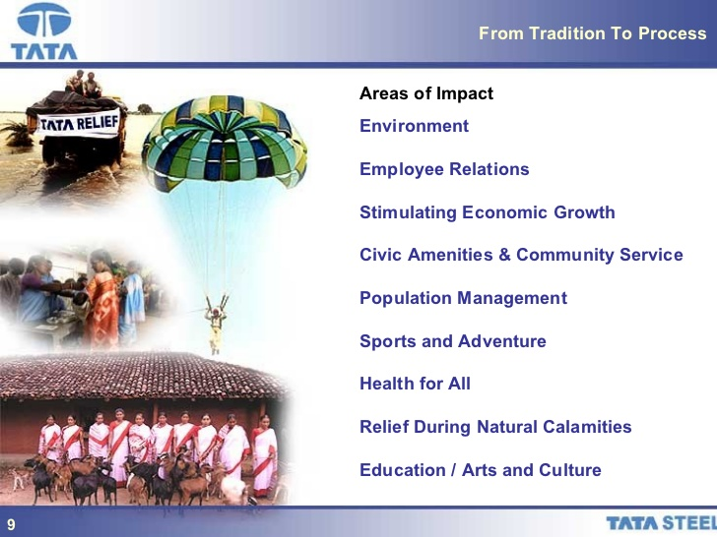

Slide 28
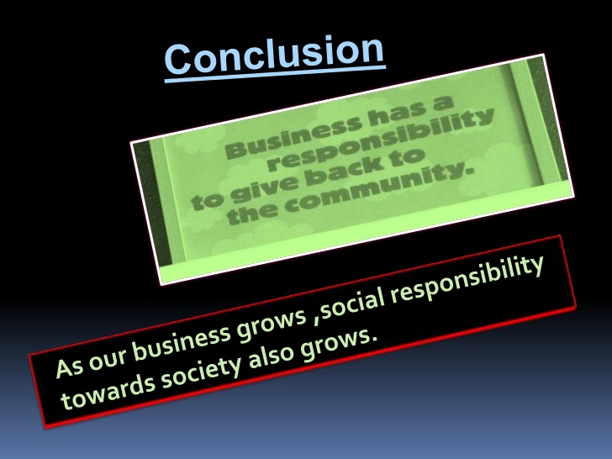

Slide 29
Corporate governance
An essential aspect of ensuring confidence in democratic market economies (OECD, 2004).
Managing the relationship between management, board members, shareholders and other stakeholders (OECD, 2004).
Central to attracting and maintaining investment.

Slide 30
Corporate governance defined?
Corporate governance is the system by which companies are directed and controlled. Boards of directors are responsible for the governance of their companies. The shareholders’ role in governance is to appoint the directors and the auditors and to satisfy themselves that an appropriate governance structure is in place. The responsibilities of the board include setting the company’s strategic aims, providing the leadership to put them into effect, supervising the management of the business and reporting to shareholders on their stewardship. The board’s actions are subject to laws, regulations and the shareholders in general meeting.
The Cadbury Report (1992, paragraph 2.5).

Slide 31
Corporate governance
Leadership
Effectiveness/capability
Accountability/transparency
Relations with shareholders
Sustainability
…but this is an evolving concept and organisations must react to this.

